Slide 1
Unit 2
Fundamentals of AC Circuits

Slide 2
Voltage | 6.2V | 11.8V | 16.2V | 19.0V | 20.0V | 19.0V | 16.2V | 11.8V | 6.2V | 0V
Angle | 18º | 36º | 54º | 72º | 90º | 108º | 126º | 144º | 162º | 180º

Slide 3
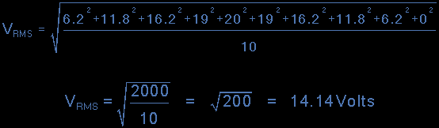

Slide 4
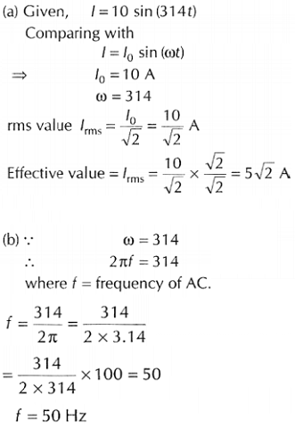
Problem on frequency and rms value

Slide 6
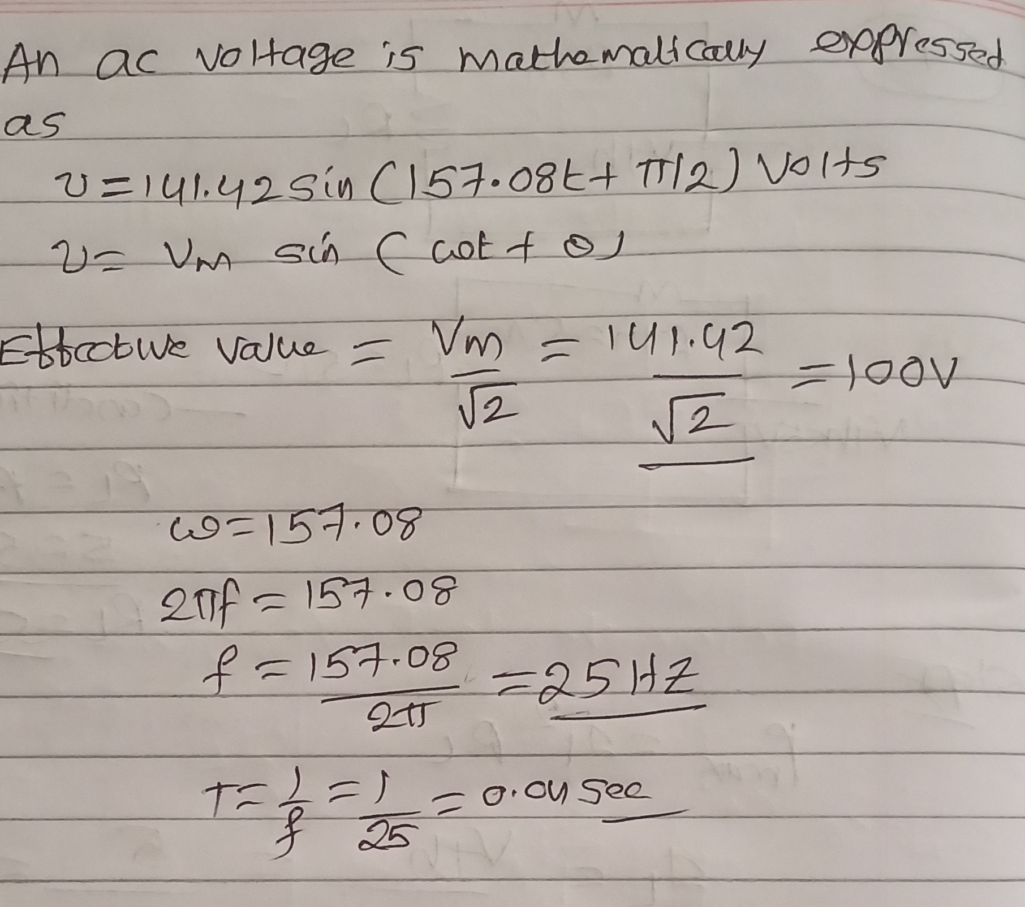

Slide 7
Problem on RMS value

Slide 8
RMS and Average value

Slide 9
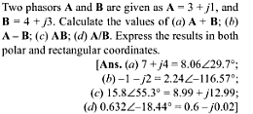
Problem on Rectangular and Polar calculations

Slide 10
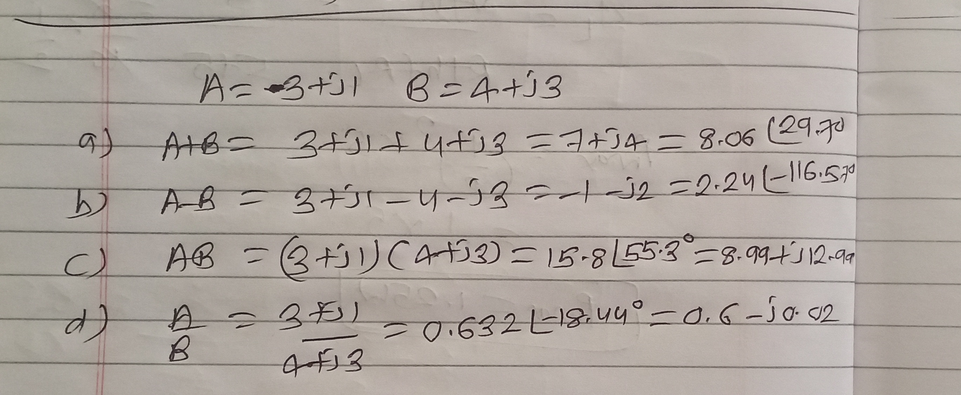
Addition subtraction and Multiplication

Slide 11
Addition subtraction and Multiplication

Slide 12
Division

Slide 13
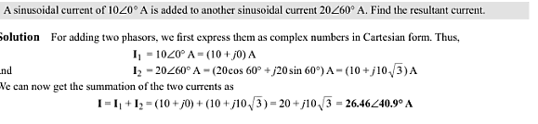
Problem on Polar calculations

Slide 14
Problem on Resultant current

Slide 15
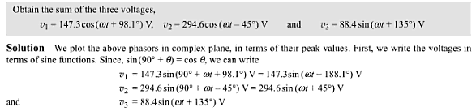
Problem on Representation of sin wave equations

Slide 16
Impedance
Impedance is a complex number, with the same units as resistance, for which the SI unit is the ohm (Ω). Its symbol is usually Z, and it may be represented by writing its magnitude and phase in the polar form |Z|∠θ. However, cartesian complex number representation is often more powerful for circuit analysis purposes. Z=R+jX

Slide 17
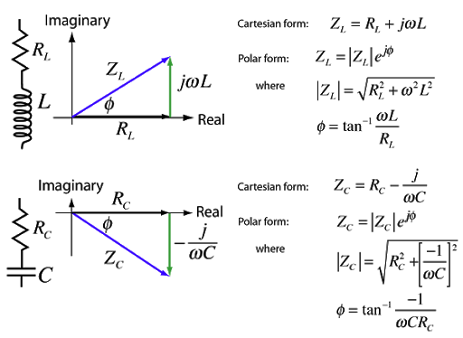
Impedance Representation

Slide 18
Basic Formulae of Z
Impedance Z = R or X_{L}or X_{C}(if only one is present)
Impedance in series only Z = √(R² + X²) (if both R and one type of X are present)
Impedance in series only Z = √(R² + (|X_{L} - X_{C}|)²) (if R, X_{L}, and X_{C} are all present)
Impedance in any circuit = R + jX (j is the imaginary number √(-1))
Resistance R = ΔV / I
Inductive reactance X_{L} = 2πƒL = ωL
Capacative reactance X_{C} = ¹ / _{2πƒC} = ¹ / _{ωC}

Slide 19
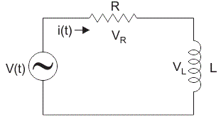
Series RL Circuit

Slide 20
Series RL Circuit
Consider a simple RL circuit in which resistor, R and inductor, L are connected in series with a voltage supply of V volts. Let us think the current flowing in the circuit is I (amp) and current through resistor and inductor is I_{R} and I_{L} respectively. Since both resistance and inductor are connected in series, so the current in both the elements and the circuit remains the same. i.e I_{R} = I_{L} = I. Let V_{R} and V_{l} be the voltage drop across resistor and inductor.

Slide 21
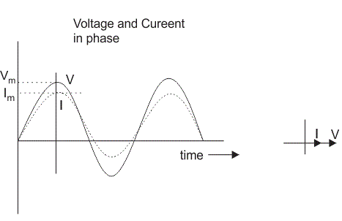
Resistor

Slide 22
Inductor
In inductor, the voltage and the current are not in phase. The voltage leads that of current by 90º or in other words, voltage attains its maximum and zero value 90º before the current attains it.

Slide 23
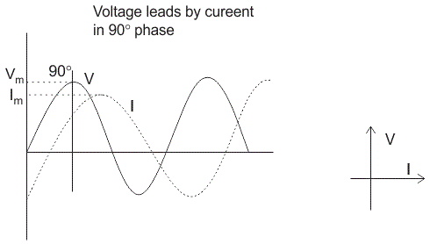
Inductor

Slide 24
Series RL circuit
Step- I. In case of series RL circuit, resistor and inductor are connected in series, so current flowing in both the elements are same i.e I_{R} = I_{L} = I. So, take current phasor as reference and draw it on horizontal axis as shown in diagram.
Step- II. In case of resistor, both voltage and current are in same phase. So draw the voltage phasor, VR along same axis or direction as that of current phasor. i.e VR is in phase with I.
Step- III. We know that in inductor, voltage leads current by 90⁰, so draw VL (voltage drop across inductor) perpendicular to current phasor.
Step- IV. Now we have two voltages VR and VL. Draw the resultant vector(VG) of these two voltages. Such as,

Slide 25
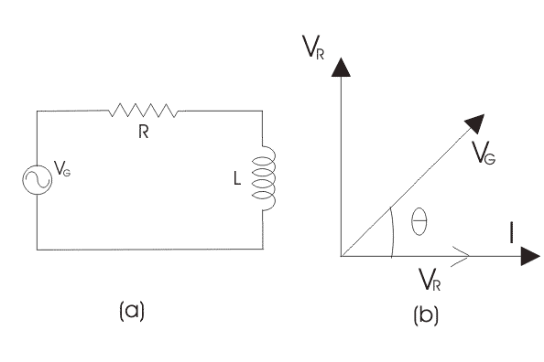
Series RL circuit

Slide 26
Impedance of Series RL Circuit
The impedance of series RL circuit opposes the flow of alternating current. The impedance of series RL Circuit is nothing but the combine effect of resistance (R) and inductive reactance (X_{L}) of the circuit as a whole. The impedance Z in ohms is given by, Z = (R² + X_{L}²)^{0.5} and from right angle triangle, phase angle θ = tan^{– 1}(X_{L}/R).

Slide 27
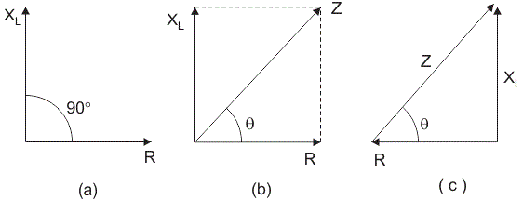
Impedance of Series RL Circuit

Slide 28
Problem on XL and XC calculation

Slide 29
Problem on Series RL circuit

Slide 30
Problem on Series RL circuit

Slide 32
Series RC circuit
An RC circuit (also known as an RC filter or RC network) stands for a resistor-capacitor circuit. An RC circuit is defined as an electrical circuit composed of the passive circuit components of a resistor (R) and capacitor (C), driven by a voltage source or current source.

Slide 33
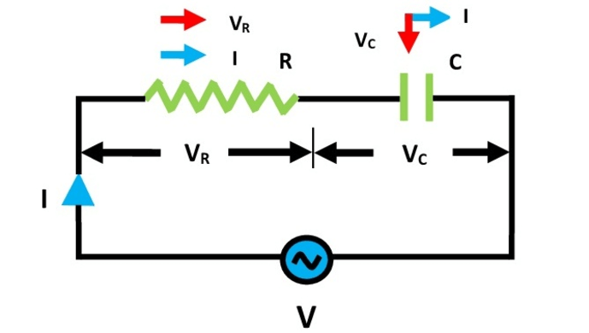
Series RC circuit

Slide 34
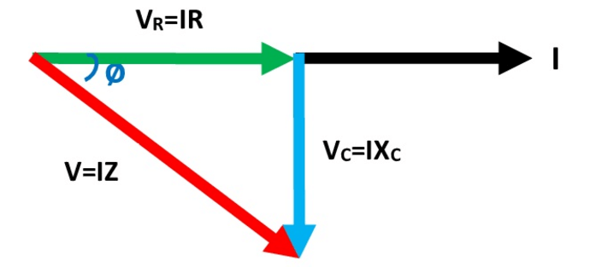
Vector Diagram of RC circuit

Slide 35
Series RC circuit
V_{R} is drawn in phase with current 'I' because in a pure resistor the voltage and current are in phase with each other.
V_{C} is drawn lagging with current 'I' by 90⁰ because in a pure capacitor voltage and current are 90⁰ out of each other i.e. voltage lags current by 90⁰ or current leads the voltage by 90⁰

Slide 36



Series RC circuit

Slide 37
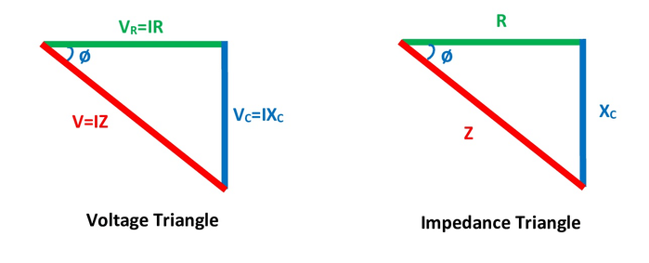
Series RC circuit

Slide 38


Series RC circuit

Slide 39
Problem on Power and RC circuit

Slide 40
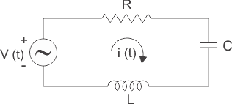
Series RLC circuit
A series RLC circuit is one the resistor, inductor and capacitor are connected in series across a voltage supply. The resulting circuit is called series RLC circuit.

Slide 41
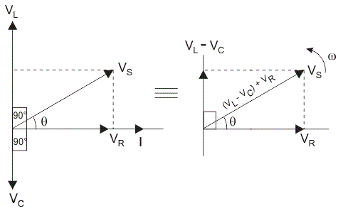
Series RLC circuit

Slide 42
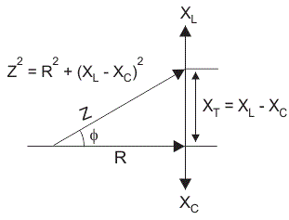
Impedance series RLC circuit

Slide 43
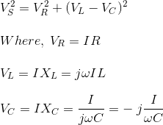
Basic Formulae Series RLC circuit

Slide 44
POWER IN AC CIRCUITS

Slide 45
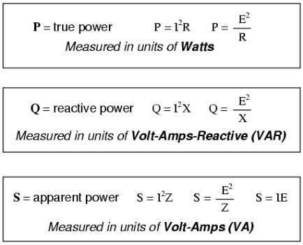
POWER IN AC CIRCUITS

Slide 46
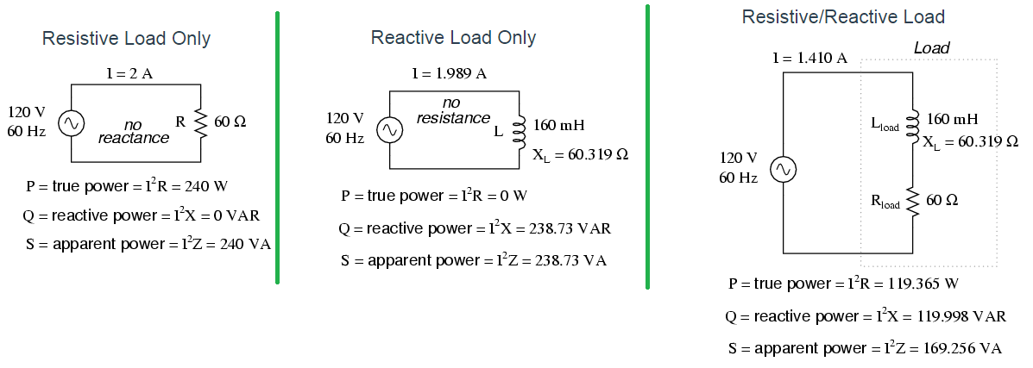
True Power, Reactive Power and Apparent Power with Resistive and Inductive Load

Slide 47
Problem on Series RLC circuit

Slide 48
Problem on series RLC circuit

